Slide 1
Synchronization Examples Lesson 1 Introduction
David Liu
Fall 2021, Spring 2022

Slide 2
Unit Learning Outcomes
Explain synchronization problems.
the bounded-buffer,
readers-writers,
dining philosophers
Describe the tools used by Linux and Windows to solve synchronization problems.
Illustrate how POSIX and Java can be used to solve process synchronization problems.

Slide 3
Bounded-Buffer Problem
n buffers, each can hold one item
Semaphore mutex initialized to the value 1
Semaphore full initialized to the value 0
Semaphore empty initialized to the value n

Slide 4
Bounded-Buffer Problem
Semaphore
mutex =1
empty = n
full = 0
producer process
consumer process
while (true) {
...
/* produce an item in next_produced */
...
wait(empty);
wait(mutex);
...
/* add next produced to the buffer */
...
signal(mutex);
signal(full);
}
while (true) {
wait(full);
wait(mutex);
...
/* remove an item from buffer to next_consumed */
...
signal(mutex);
signal(empty);
...
/* consume the item in next consumed */
... }

Slide 5
Bounded Buffer Problem Questions
If the first arriving process is a producer?
If the first arriving process is a consumer?
If an arriving producer finds a full buffer?
If an arriving consumer finds a empty buffer?
What is a normal situation for an arriving producer or a consumer?

Slide 6
Readers-Writers Problem
A data set is shared among a number of concurrent processes
Readers – only read the data set; they do not perform any updates
Writers – can both read and write
Requriment
allow multiple readers to read at the same time
Only one single writer can access the shared data at a time
Variations
First readers-writer problem: readers-preference
Second readers-writer problem: writers-preference
Third readers-writer problem: fairness

Slide 7
Readers-Writers Problem
Shared Data
Data set
Semaphore rw_mutex initialized to 1
Semaphore mutex initialized to 1
Integer read_count initialized to 0

Slide 8
Readers-Writers Problem
mutex = 1
rw_mutex = 1
read_count = 0
Reader Process
Writer Process
while (true){
wait(mutex); read_count++; if (read_count == 1)
wait(rw_mutex);
signal(mutex);
...
/* reading is performed */
...
wait(mutex); read count--; if (read_count == 0)
signal(rw_mutex);
signal(mutex);
}
while (true) {
wait(rw_mutex);
...
/* writing is performed */
...
signal(rw_mutex);
}

Slide 9
Readers-Writers Problem
Reader Process
Writer Process
If the first process is a reader
If an arriving reader finds one or more readers is reading
If an arriving reader finds one writer is writing
First waiting reader
Later waiting reader
If the first process is a writer
If an arriving writer finds one or more readers is reading
If an arriving writer finds one writer is writing

Slide 10
Readers-Writers Problem
Queues
rw_mutex waiting queue
who
when
why
Purpose (goal)
mutex waiting queue
who
when
why
Purpose (goal)

Slide 11
Readers-Writers Problem Variations
First variation – no reader kept waiting unless writer has permission to use shared object
Second variation – once writer is ready, it performs the write ASAP
Both may have starvation leading to even more variations
Problem is solved on some systems by kernel providing reader-writer locks

Slide 12

Dinning-Philosophers Problem
P1
C1
P0
Philosophers spend their lives alternating thinking and eating
Don’t interact with their neighbors, occasionally try to pick up 2 chopsticks (one at a time) to eat from bowl
Need both to eat, then release both when done
In the case of 5 philosophers
Shared data
Bowl of rice (data set)
Semaphore chopstick [5] initialized to 1
C2
C0
P2
P4
C3
C4
P3

Slide 13
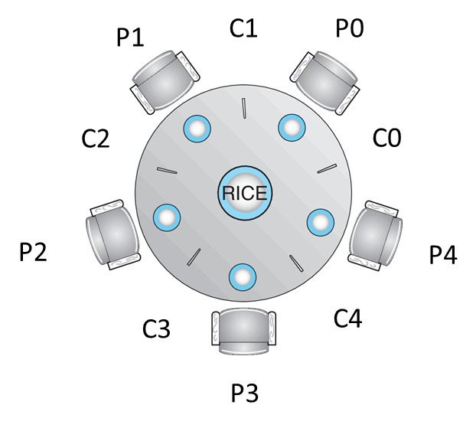
DP Semaphore Solution
Structure of Philosopher i:
while (true){
wait (chopstick[i] );
wait (chopStick[ (i + 1) % 5] );
/* eat for awhile */
signal (chopstick[i] );
signal (chopstick[ (i + 1) % 5] );
/* think for awhile */
}
Left chopstick
Any problem with this algorithm?

Slide 14
DP Monitor Solution
monitor DiningPhilosophers
{
enum { THINKING; HUNGRY, EATING) state [5] ;
condition self [5];
void pickup (int i) {
state[i] = HUNGRY;
test(i);
if (state[i] != EATING) self[i].wait;
}
void putdown (int i) {
state[i] = THINKING;
// test left and right neighbors
test((i + 4) % 5);
test((i + 1) % 5);
}
void test (int i) {
if ((state[(i + 4) % 5] != EATING) &&
(state[i] == HUNGRY) &&
(state[(i + 1) % 5] != EATING) ) {
state[i] = EATING ;
self[i].signal () ;
}
}
initialization_code() {
for (int i = 0; i < 5; i++)
state[i] = THINKING;
}
}

Slide 15
DP Monitor Solution
Deadlock?
Starvation?

